Slide 1

Intro to JavaScript Tooling in Visual Studio Code
November 9, 2015
MadJS

Slide 2





About me and this talk
Scott Addie
.NET Solutions Architect
MCSD (Web Apps)
Visual Studio Code Insider
GitHub.com/scottaddie/slide-decks
ScottAddie.com
@Scott_Addie
LinkedIn.com/in/scottaddie

Slide 3



About VS Code
Launched on April 29th at //Build/ conference
Preview release
Current = v0.9.2
Free product
Lightweight
Microsoft’s 1st cross-platform code editor

Slide 4

About VS Code
An editor, not an IDE
Based on GitHub’s Electron shell
Designed by engineers who created:
Eclipse @ IBM
Monaco @ Microsoft
Built with the 3 pillars of the web

Slide 5

Instead of making them [Linux and Mac developers] go to Windows, we want to meet them where they are.
S. “Soma” Somasegar – Microsoft - Corporate VP of Developer Division
Quote retrieved from http://tcrn.ch/1PwSw1r

Slide 6
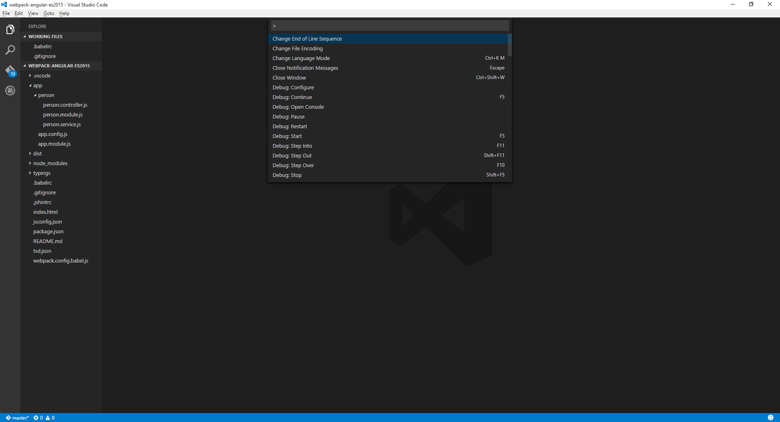
A Quick Tour of the Editor
File Explorer
Command Palette
File Search
Git Tools
Debugger
Send Feedback
Git Repo Branch

Slide 7
4 Notable JSON Configuration Files
File Name | Location | Common Uses
jsconfig.json | Project root or subfolder | Enable ES6 support
launch.json | .vscode/ | Debugger configuration
settings.json | .vscode/ - or - %APPDATA%\Code\User\ | Override editor settings
tasks.json | .vscode/ | Define custom tasks to run with built-in task runner

Slide 8
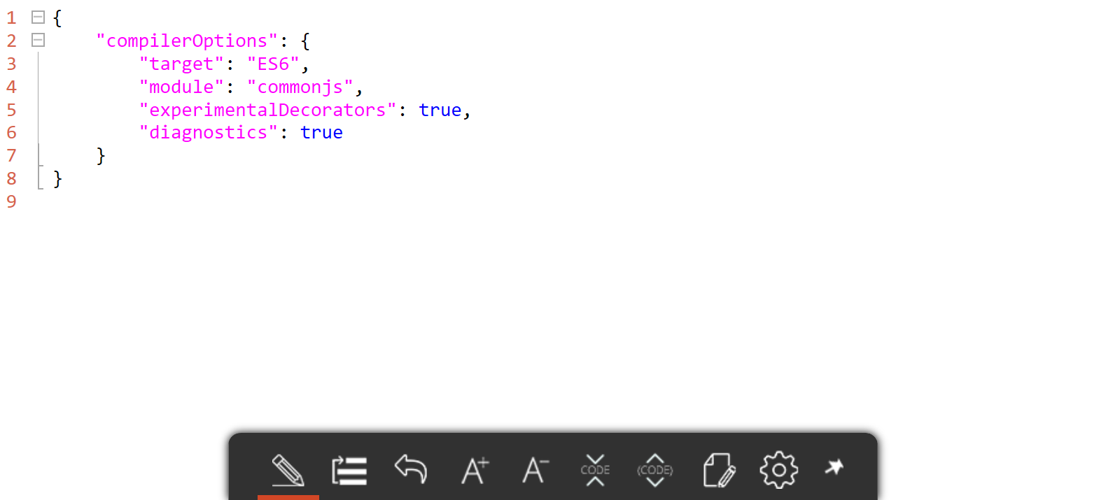
1. jsconfig.json

Slide 9
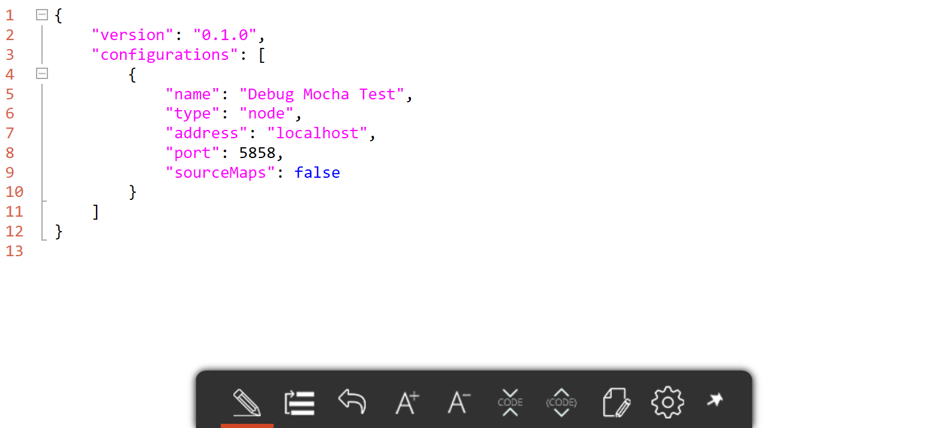
2. launch.json

Slide 10
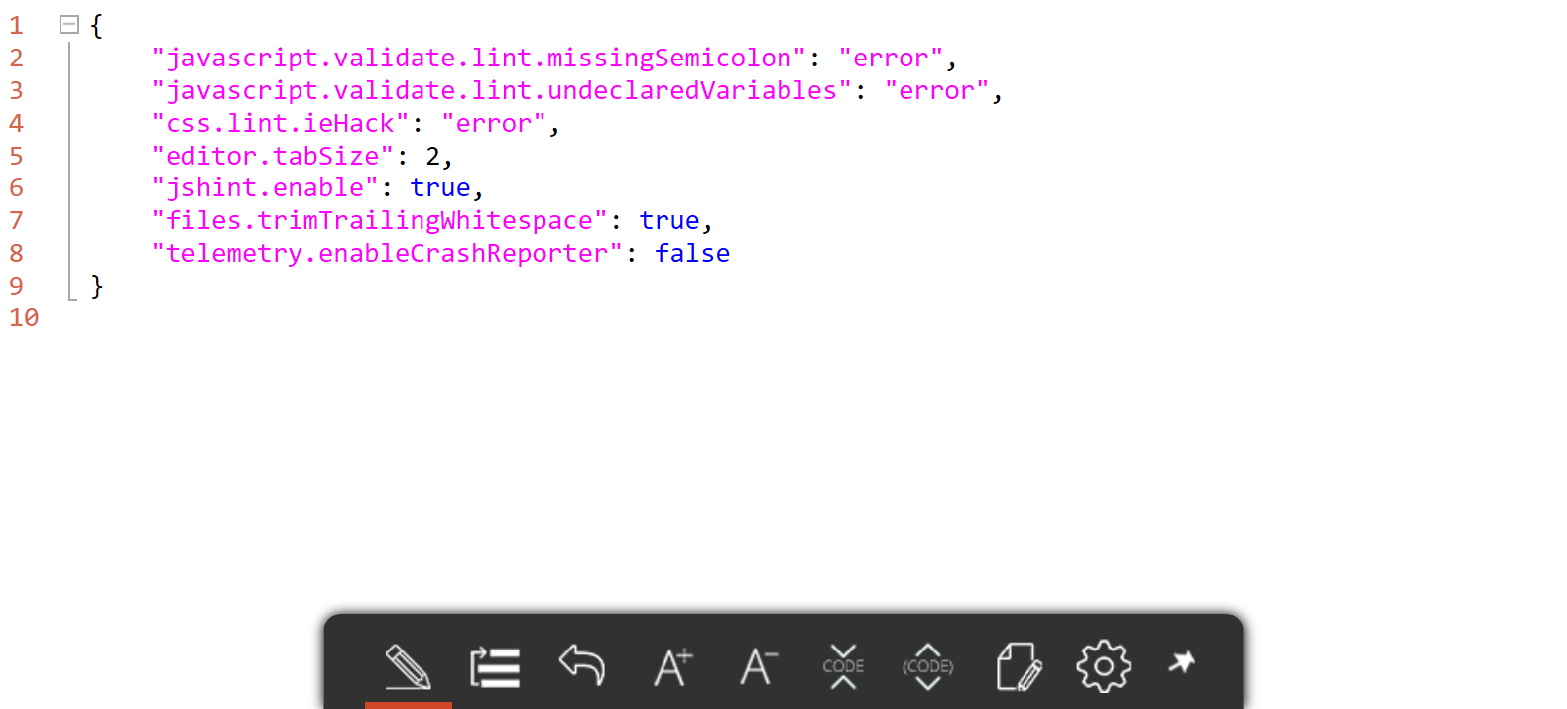
3. settings.json

Slide 11
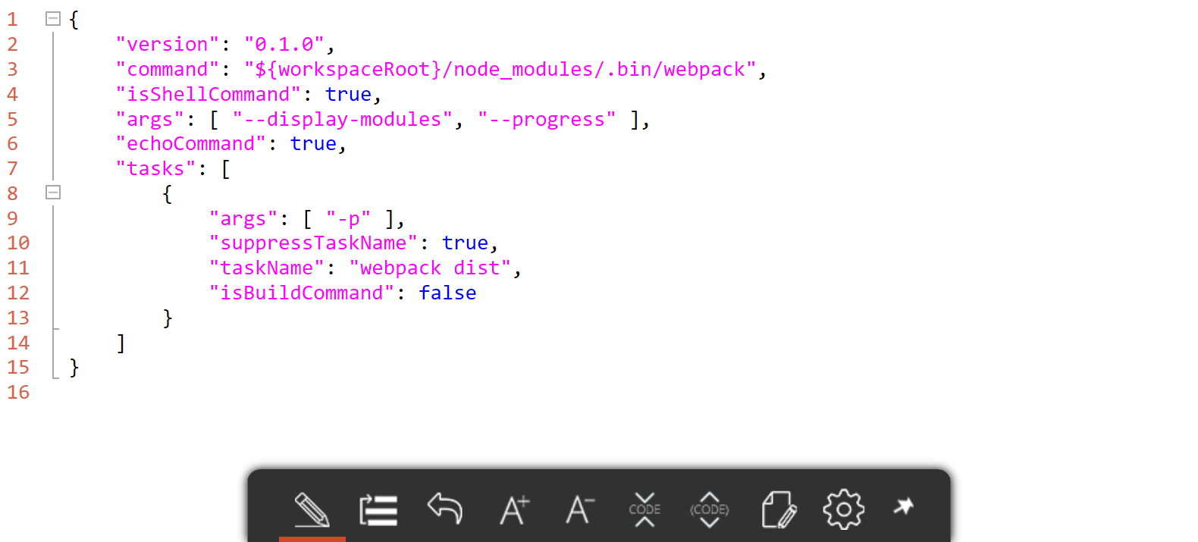
4. tasks.json

Slide 12
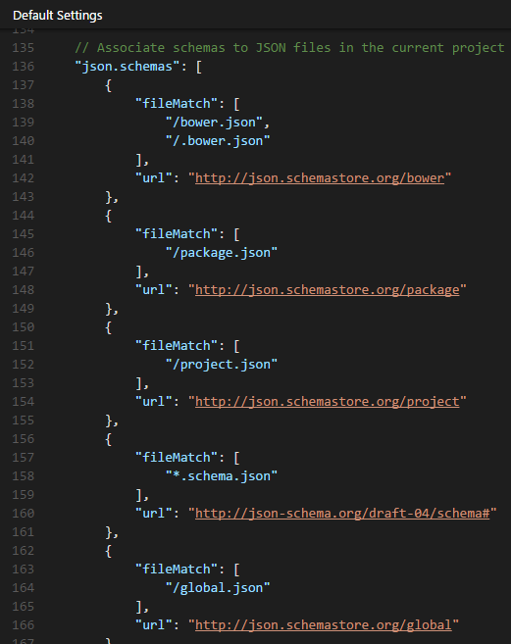
JSON Schema Support json.schemastore.org
npm
package.json
Bower
bower.json
.bowerrc
JSCS
.jscsrc
JSHint
.jshintrc
TypeScript
tsconfig.json

Slide 13
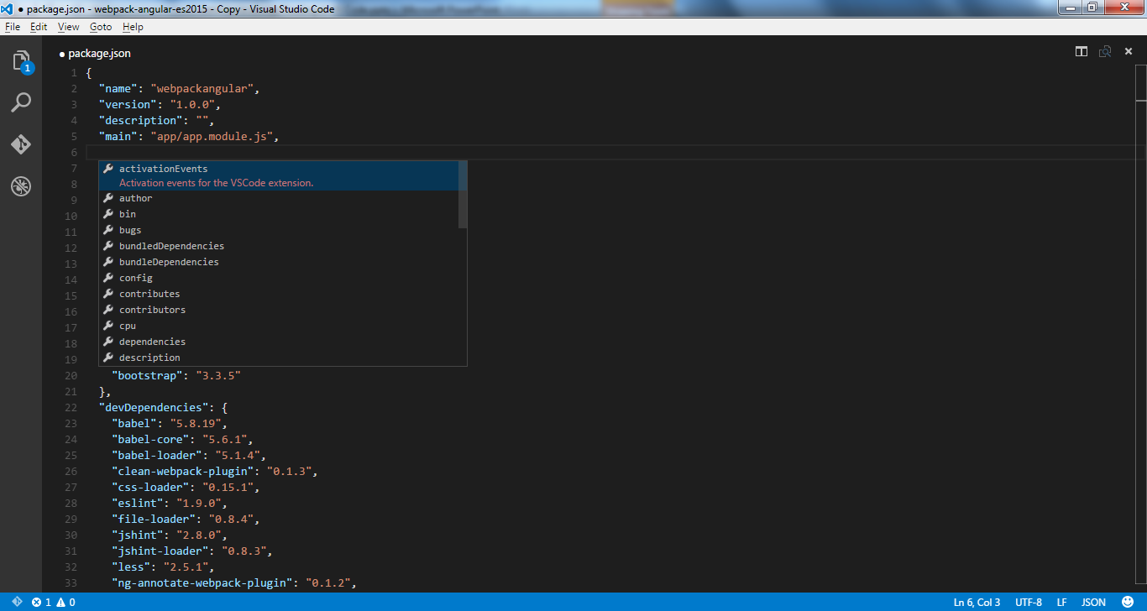
package.json Schema Support

Slide 14

Demo
let demo = + ;
Extending JSON Schema Support for ESLint

Slide 15

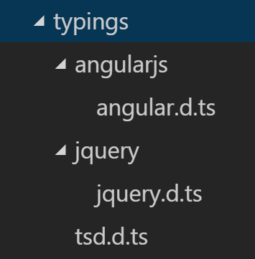
Library / Framework IntelliSense
Reliance on DefinitelyTyped project
Prerequisite: TypeScript Definition Manager
> npm install –g tsd
*.d.ts files provide metadata to editor
angular.d.ts, jquery.d.ts, etc.

Slide 16
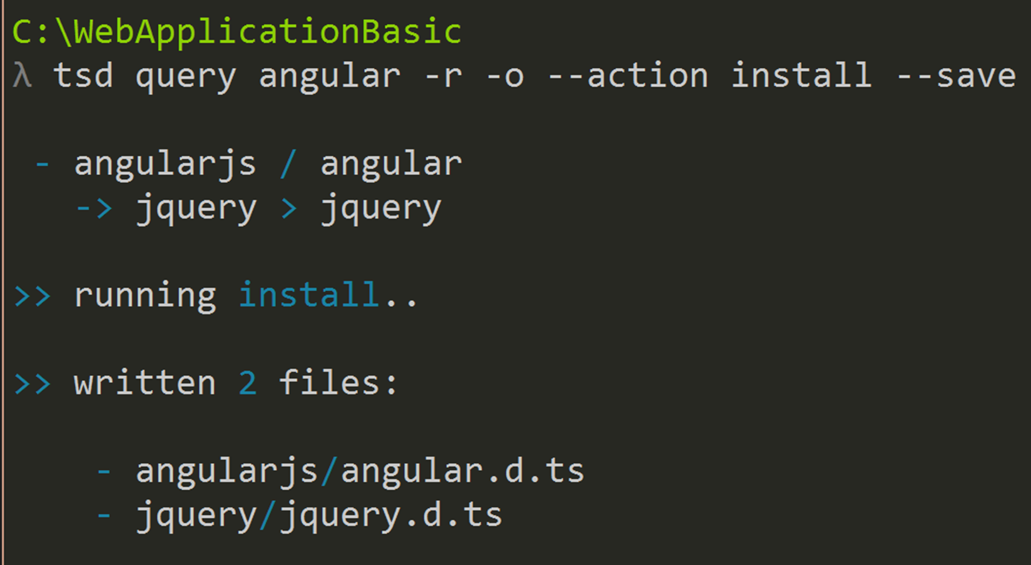
Enable IntelliSense via Command Shell

Slide 17
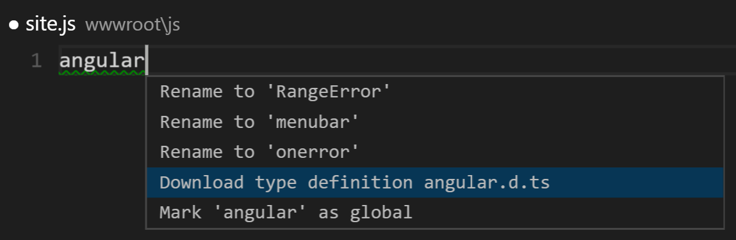
…or Enable IntelliSense via Editor

Slide 18
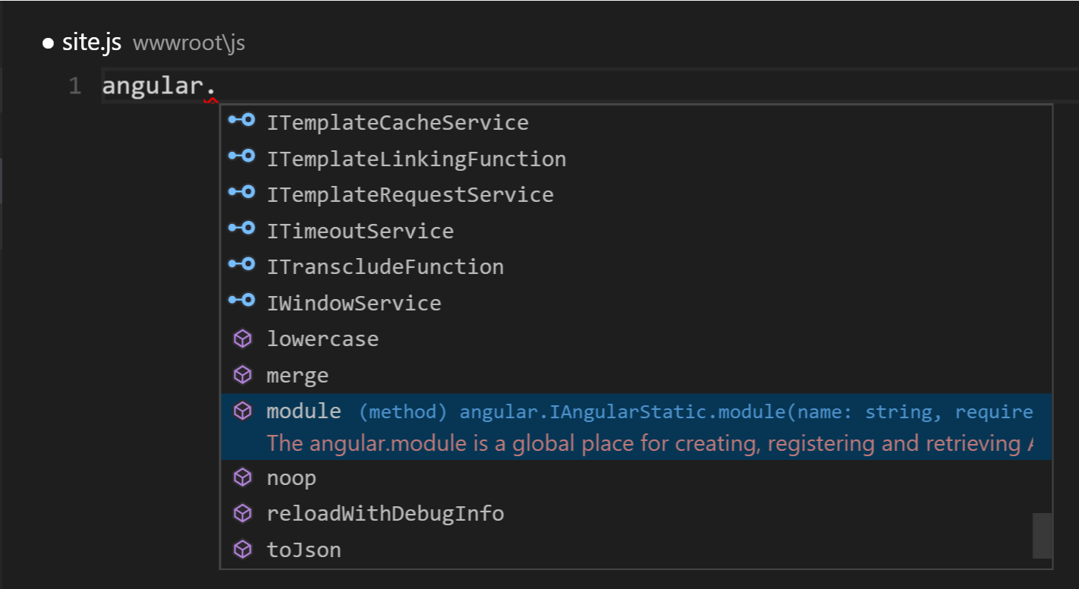
IntelliSense in Action

Slide 19

Demo
let demo = + ;
Enabling CommonJS Support

Slide 20
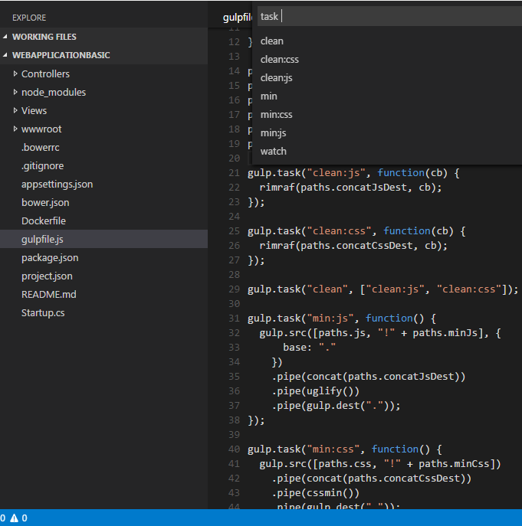
JS Task Runners
>Tasks: Run Task
Command Palette
Discoverable
Launchable
1st class support for:
Grunt
Gulp
Jake
Terminate running tasks:
>Tasks: Terminate Running Task

Slide 21
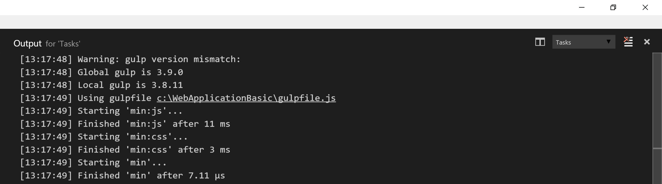
Task Output

Slide 22

Demo
let demo = + ;
Discovering & Debugging Gulp Tasks

Slide 23
Built-in Task Runner
VS Code has its own task runner
Integrate w/ 3rd party tools:
Babel
Webpack
etc.
“isBuildCommand” property ties to Shift + Ctrl + B gesture
“isTestCommand” property ties to Shift + Ctrl + T gesture

Slide 24
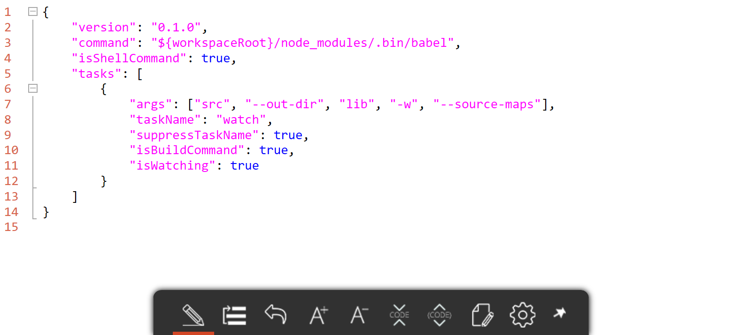
Babel Transpilation Task tasks.json

Slide 25

Demo
let demo = + ;
Running Custom Webpack Build Task

Slide 26
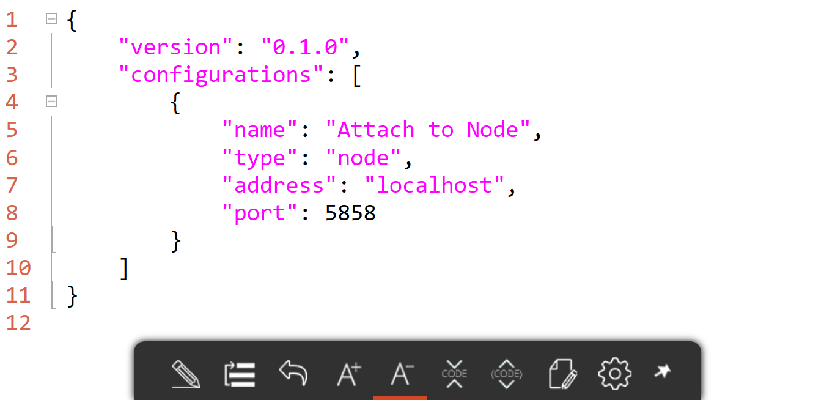
Node.js Debugging launch.json
Default launch configuration provided:

Slide 27
Node.js Debugging (cont.)
3 easy steps:
Configure launch.json for Node.js debugging
Launch Node.js program like this:
node --debug-brk program.js
Attach VS Code debugger to running program
--debug and --debug-brk supported
--debug-brk stops on 1st line of program

Slide 28

Demo
let demo = + ;
Debugging Mocha Unit Tests

Slide 29
Backlog Items
Plugins support
Improved JSX support
npm package.json script discoverability
ES7 support

Slide 30

Resources
Scan QR for slides:
Official VS Code website
VS Code Docs
Visual Studio Code
John Papa, Pluralsight course
VS Code ES6 Sample Project
GitHub repo

